Slide 1


Scalability in Practice: a Highly scalable web app
SE124 (2023 Fall)
Yubin Xia
IPADS, Shanghai Jiao Tong University
https://www.sjtu.edu.cn

Slide 2




Scalable web apps are everywhere: pre-AI era
High request rate
100 billions of requests daily
Massive data
Facebook has more than 1 billion of images uploaded weekly, Baidu stores tens of billions of web pages

Slide 3

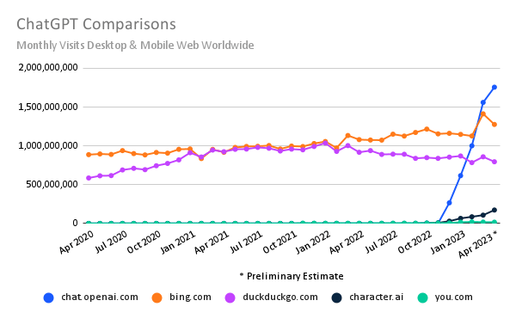
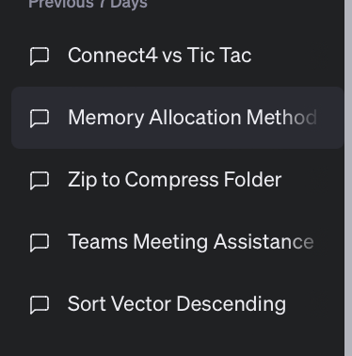
Scalable web apps are everywhere: AI era
Essentially, also a web APP
Pre-AI era: request handling = order an item
AI era: request handling = use model to do an inference
The same system requirements
High request rate
Massive data: both for training & for serving history data
New requirements
Huge computation power required
According to GPT (☺), an inference of GPT ~= sorting 100,000,000 numbers
Per-user sessions
Notes:
ChatGPT access data: https://www.similarweb.com/blog/insights/ai-news/chatgpt-growth-flattens/
要确切地回答GPT-4运行一次推理所需的计算能力与传统计算（如排序）的等价关系，需要具体地了解两个任务的计算复杂性和所用的硬件。然而，我们可以对这个问题进行一个简化的概述。
GPT-4的推理:
GPT-4进行一次推理（即生成一个响应）通常只涉及前向传播，而不涉及训练。这意味着每个神经元需要与其输入进行一次乘法操作，然后加上一个偏差，并通过激活函数。
由于GPT-4有数十亿的参数，所以每次推理需要数十亿的这样的操作。这还取决于所选的序列长度和模型配置。
排序:
最常用的排序算法，如快速排序或归并排序，具有O(n log n)的平均时间复杂性，其中n是待排序的元素数量。
如果我们要排序1亿个数字，所需的操作数将是在10亿到100亿之间，这取决于常数因子和排序的数据。
如果我们进行一个非常粗略的比较：
对于GPT-4的一个简单推理与对1亿个数字的排序，所需的计算操作大致是同一个数量级的。
但请注意，这是一个非常简化和粗略的比较。实际上，不同的计算任务在不同的硬件上有着不同的效率，因此即使两者需要相同数量的操作，它们也可能在实际执行时间上有所不同。
此外，实际的操作复杂性和所需的计算能力取决于实际的任务参数和所使用的实现细节。

Slide 4
The fundamental system techniques remain similar AI is just another (challenging) workload

Slide 5
Case study: a e-commerce website

Slide 6
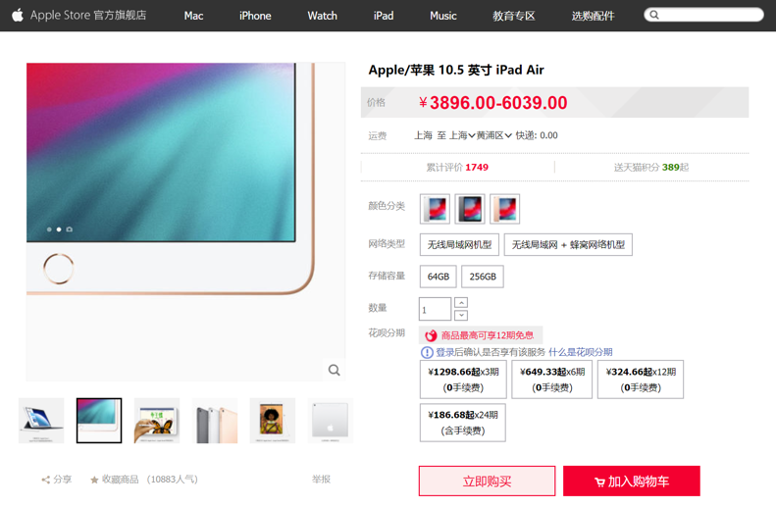
Different storage systems to support different services
Database
File system
Key-value store
Notes:
Distributed storage

Slide 7

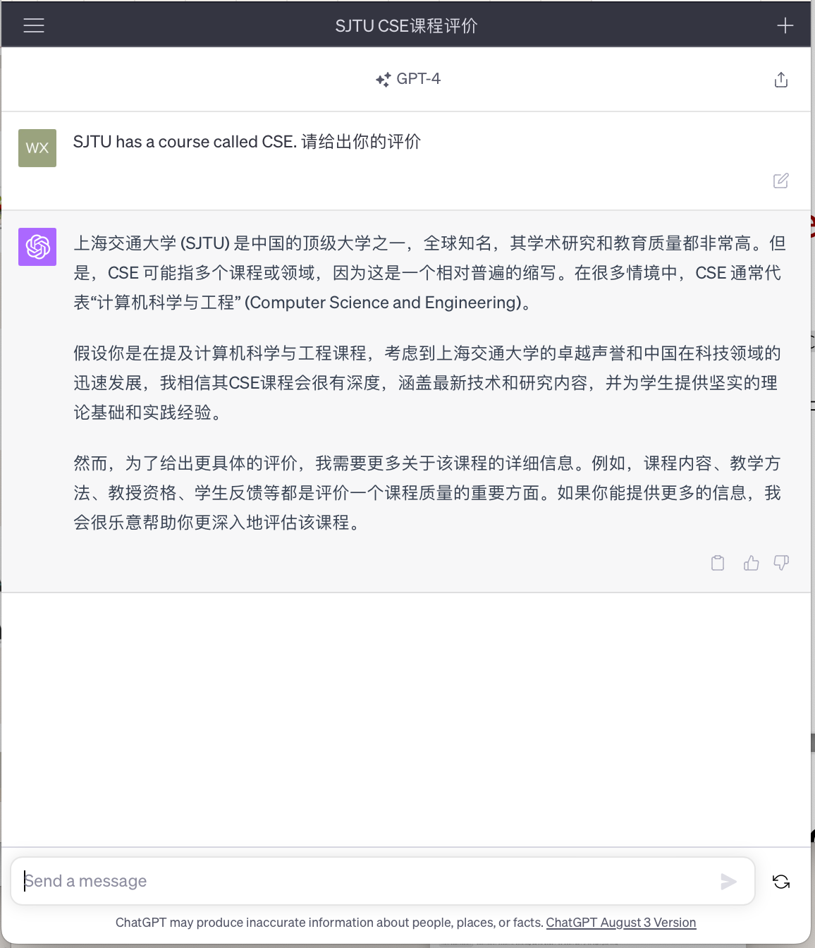
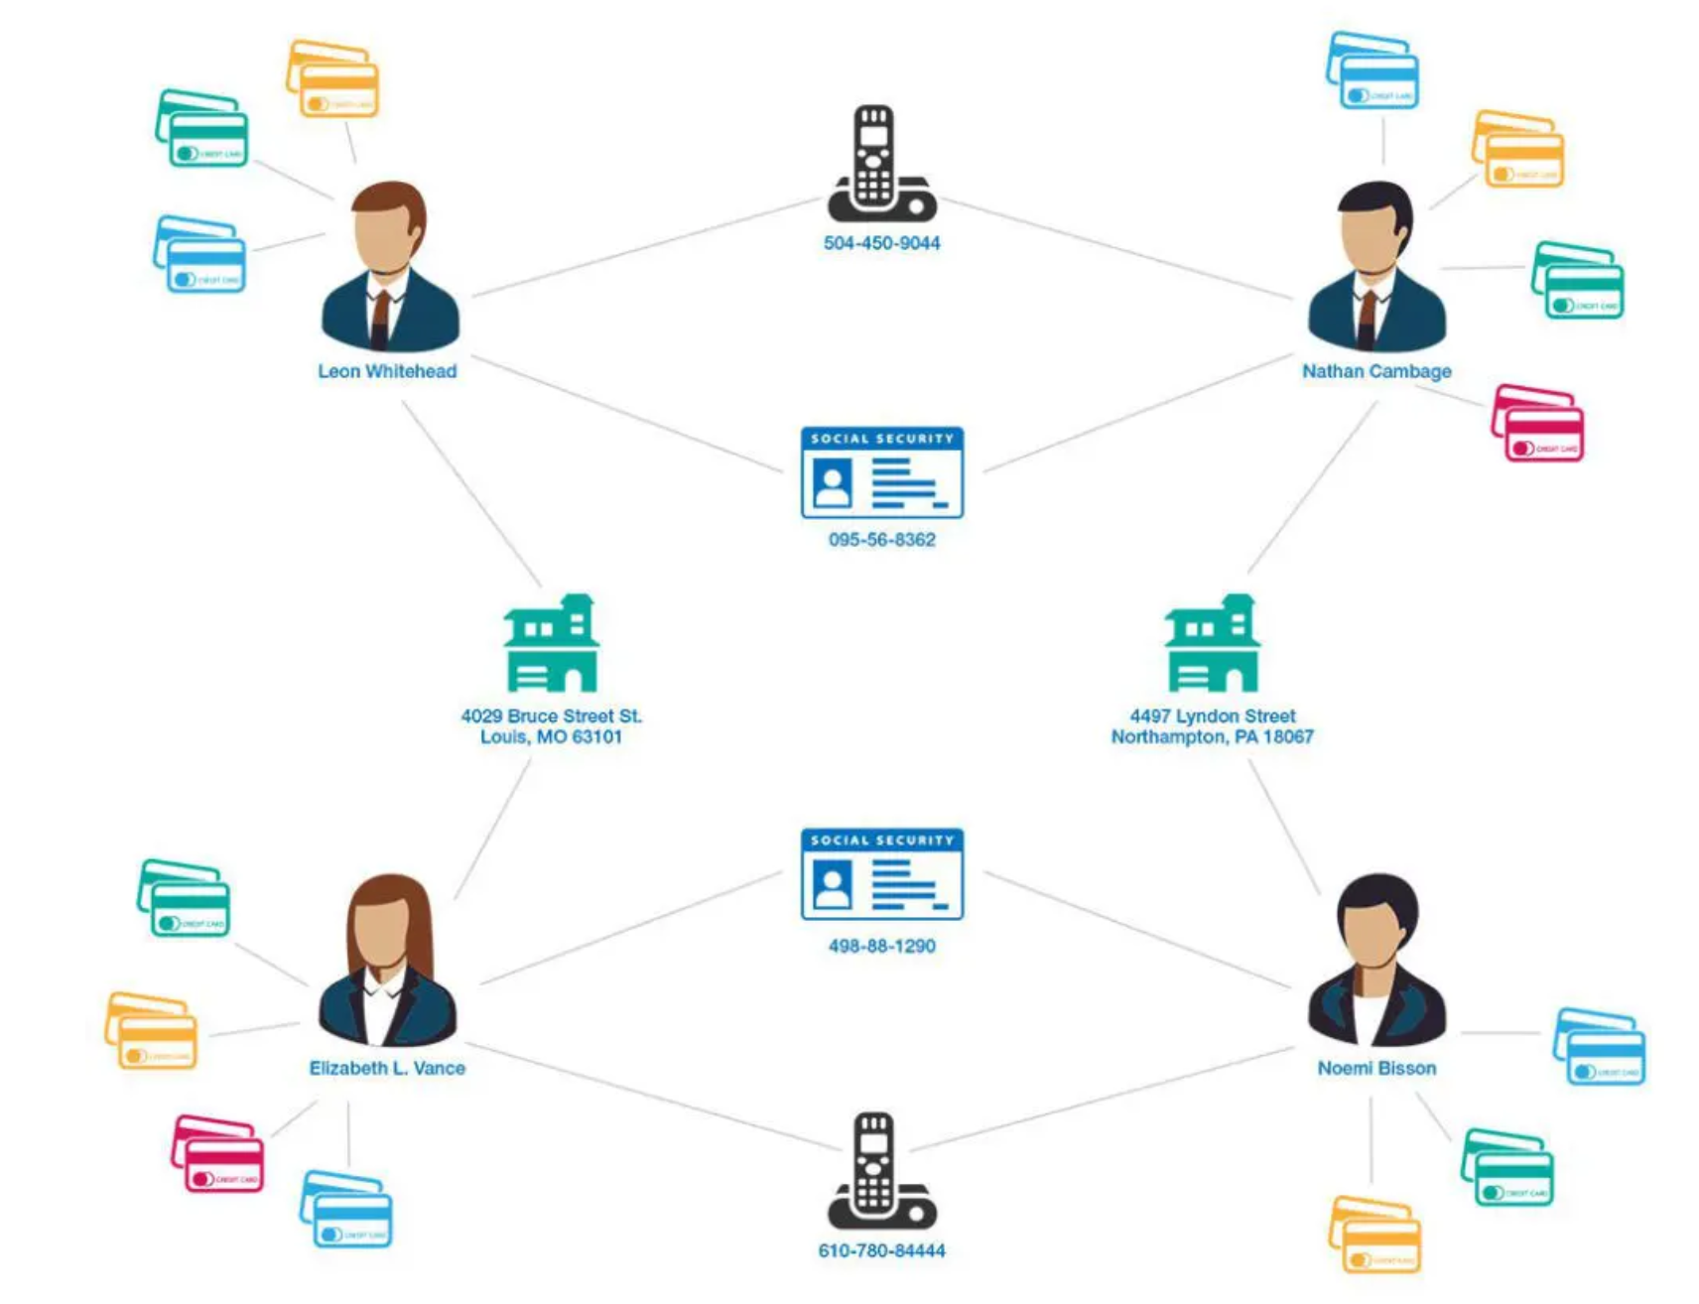
Computation frameworks to support different services
Hot topics
Fraud detection
Chat Bot
Graph processing system
Source: https://www.graphable.ai/blog/graph-database-fraud-detection/
Batch processing system
ML systems
Notes:
Massive data -> require massive computation

Slide 8

Each click needs thousands of servers to cooperate
Caching server
Caching server
…
Caching server
Caching
Caching
Caching
Distributed caching
Database server
Database server
CDN
Users
Application #1
generate the page
Database
user, price
…
Database
user, price
Application server
Distributed database
Internet
Load
Balance
Application #2
add the order
File server
File server
File server
File:
image
File:
image
…
File:
image
Application server
…
…
Message queue
Distributed file system

Slide 9
How to build Taobao on a single machine (in old days)?
Operating system:
Linux (in OS class)
Serving the requests: web server
Apache, Nginx (in ICS)
Serving the data: file system & DB
MySQL & inode file system (in CSE)
Displaying the page: HTML
PHP (in Web class)
LAMP = Linux + Apache + MySQL + PHP

Slide 10

Using one server to build Taobao
https://www.taobao.com
Internet
Application
generate the web page
File:
image
Database:
user, price
Server
Notes:
// todo: refine

Slide 11
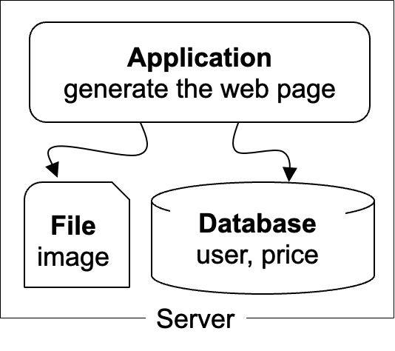
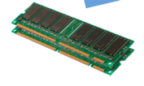
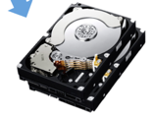
The architecture of LAMP cannot scale!
https://www.taobao.com
Internet
The disk & memory of one server cannot store massive amount of data
DRAM: 64 – 256 GB
HDD: 2 – 40 TB
Facebook has more than 1 billion of images uploaded weekly, Baidu stores tens of billions of web pages
File:
image
Database:
user, price
DRAM
HDD

Slide 12
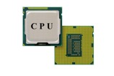
The architecture of LAMP cannot scale!
https://www.taobao.com
Internet
Application uses the CPU for processing, while a single CPU can hardly scale due to the end of Moore’s law & Dennard scaling
Moore’s law: the number of transistors in a dense integrated circuit (IC) doubles about every two years.
Dennard scaling: as transistors get smaller, their power density stays constant
Application
generate the web page

Slide 13

Step #1 for scalability: disaggregating application & data
Scale
Application: handles application logic
Can be scaled with more CPUs
Database: requires reading/writing disk & cache
Can be scaled with faster disks & larger memory
File system: store large bulks of data
E.g., images, videos
Can be scaled with faster disks
Application
generate the web page
Application server
Local area network
File server
Database server
Scale
Scale
File:
image
Database
user, price
Database
user, price
Notes:
// TODO: add figure

Slide 14
Step #2 Avoid the slow data accesses? Caching
Observation: most requests access a small portion of the data (locality)
Caching system with a single node:
E.g., page cache
Drawbacks: limited DRAM capacity
Distributed caching server
Benefits: huge DRAM capacity, e.g., deploy many caching servers
Application
generate the web page
Application server
Local area network
Caching server
Caching server
Caching
Caching
File server
Database server
File:
image
Database
user, price

Slide 15
Case study of distributed cache server: Memcached
Distributed caching server
Benefits: huge DRAM capacity
Memcached server
Store all the cached data in memory
Can scale out to use multiple servers
Memcached clients
Check whether server has cached data
On cache miss, fallback to database/file
Question:
How to find which server has cached the data?
Application
generate the web page
Net
Comm
Memached API
S0: 10.0.0.100
S1: 10.0.0.101
Routing
Application server
Local area network
Caching server#0:
10.0.0.100
Caching server#1:
10.0.0.101
Caching
Memached
Caching
Memached

Slide 16
Case study of distributed cache server: Memcached
Naïve method, hashing:
address = key / #server
Problem:
What if we add a new server?
Suppose that we add server from 3→4
Then there would be 75% miss!
Solution: consistent hashing
Suppose that we add server from 3→4
It will only incur 25% miss
More details in later courses
How to find the data?
Consistent hashing

Slide 17
Step #3 for scalability: more servers
Internet
For stateless application servers
E.g., web servers
We can add more servers for scaling its performance
What is stateless?
The server only executes the logic that only relies on input data but no long-term state
Benefits:
Better fault-tolerance
Better elasticity
Application
generate the web page
Application
generate the web page
Application
generate the web page
Application server #N
Application server #N
Application server #N
Local area network
Caching server
Caching server
Caching
Caching
File server
Database server
File:
image
Database
user, price

Slide 18
Step #3 for scalability: How to do the load balance?
Load balance: how to route the user quests to the application servers?
Leverage the network layer
HTTP redirection,
reverse proxy,
…
Load balance algorithms
round-robin,
random,
hashing,
…
Internet
Load balancer
Application
generate the web page
Application
generate the web page
Application
generate the web page
Application server #N
Application server #N
Application server #N

Slide 19
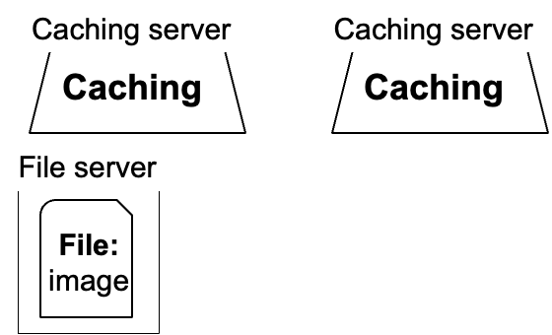
Step #4 for scalability: scaling database
#1. Separate the database for read/write
E.g., use primary-backup replication
The primary servers the writes and backup only serves reads
#2. Separate a table on multiple databases
e.g., a bank has reported that a single table has 100,000,000 rows
However, split a table on multiple machines complex consistency management
Application
generate the web page
Application
generate the web page
Application
generate the web page
Application server #N
Application server #N
Application server #N
Local area network
Write
Read
Database server
Database server
Database
user, price
Database
user, price

Slide 20
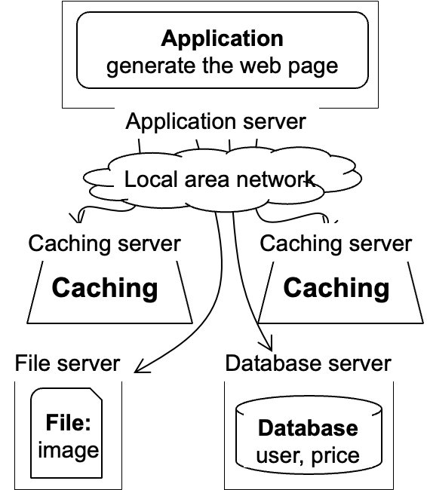
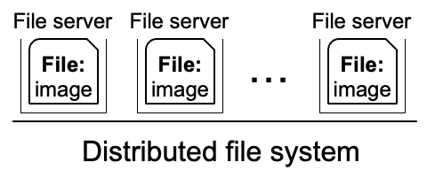
Step #5 for scalability: using distributed file system
Using multiple database in principle makes the database distributed
We can use a similar approach to make the file system distributed !
Well-known distributed file system
NFS (Network file system)
GFS (Google file system)
HDFS
Application
generate the web page
Application server
Local area network

Slide 21
Step #6 for scalability: using CDN
Goal: return the results to user as soon as possible
Why? Amazon has reported that 100ms latency increase will cause 1% financial loss
Core idea: caching (again)
E.g., CDN (content delivery network) caches the content at the network providers, which is closer to users
Challenge: how to do it without users’ awareness?
CDN
Users
Application
generate the web page
Internet
Application server
…

Slide 22


Step #7 for scalability: separate different applications
Use dedicated servers for different applications
E.g., micro-services
Application #1
Alipay
Internet
Application server
Application #2
Taobao
Application server

Slide 23
How different applications communicate? MQ or DB
Message queue (MQ): applications send the message the queue, and the queue can buffer the message (somewhere between RPC and database)
E.g., Apache Kafka
Or, applications can directly use the databases, caching (e.g. KV) or file system to communicate with shared data
Internet
Application #1
Alipay
Application #2
Taobao
Application server
Application server
Local area network
Caching server
Message queue
Caching
Database server
File server
Database
user, price
File:
image

Slide 24

How to handle complex requests?
Example: after the website becoming larger, handling requests is far more than displaying a (static) web page
Alipay (支付宝)
E.g., fraud detection
Taobao
Hot list (热榜)
Dynamic product ads (千人千面)
Recommendation (you might also like)
…
Hot lists
Customized ads

Slide 25
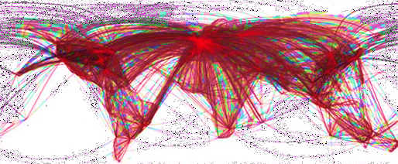

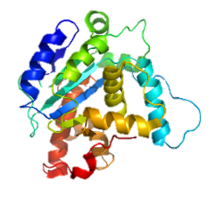
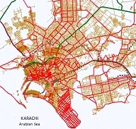
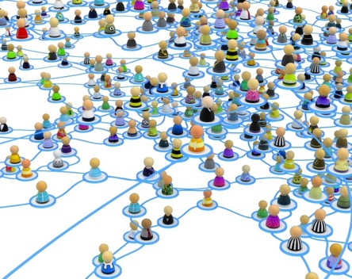


Use distributed computing frameworks for complex queries
General batch processing systems
MapReduce, Spark, etc.
Graph processing systems
GraphLab, Pregel, etc.
Machine learning systems
Tensorflow, pytorch, etc.

Slide 26
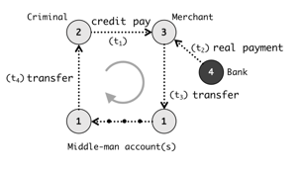

Step #7: separated applications + distributed computing
Example (Each system is backed by multiple machines)
Use general batch processing system to generate hot list
Use graph system to detect credit card fraud
ML framework
e.g., Pytorch, Deepspeed
Application #3
Chatbot
Application server
Application #1
Alipay
Graph processing
e.g., GraphLab
Internet
Application server
Generate hot lists
Application #2
Taobao
Batch processing
e.g., MapReduce
Application server

Slide 27
A scalable website: overall picture
We have not covered all the parts
E.g., container
Yet most of them are orthogonal to the scalability concepts in this class
Caching server
Caching server
Caching server
…
Caching
Caching
Caching
Distributed caching
Database server
Database server
CDN
Users
Application #1
generate the page
Database
user, price
…
Database
user, price
Application server
Distributed database
Internet
Load
Balance
Application #2
add the order
File server
File server
File server
File:
image
File:
image
…
File:
image
Application server
…
…
Message queue
Distributed file system

Slide 28
Recall: we have talked about distributed system
But what is a distributed system?

Slide 29
A scalable website: powered by distributed systems!
Distributed system: a collection of independent/autonomous connected through a communication network working together hosts to perform a service
Caching server
Caching server
Caching server
…
Caching
Caching
Caching
Distributed caching
Database server
Database server
CDN
Users
Application #1
generate the page
Database
user, price
…
Database
user, price
Application server
Distributed database
Internet
Load
Balance
Application #2
add the order
File server
File server
File server
File:
image
File:
image
…
File:
image
Application server
…
…
Message queue
Distributed file system

Slide 30
Modern scalable system systems are
large & distributed
Powered by large-scale datacenter

Slide 31
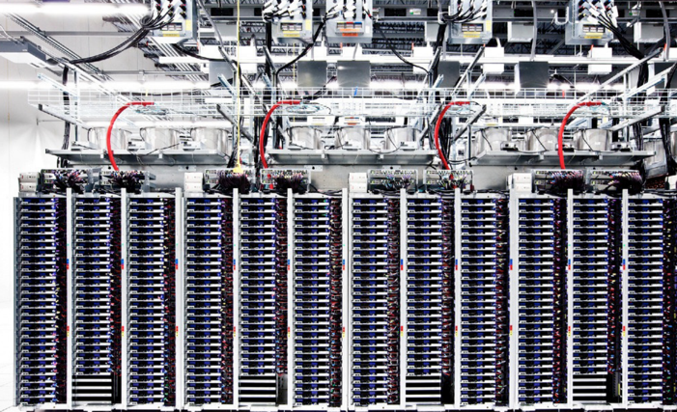
Scalable websites are powered by modern datacenters
Large server and storage farms
CPUs: > 20,000,000 cores
Disk capacity: > 1,000,000 GB
Caching server
Caching server
…
Caching server
Caching
Caching
Caching
Distributed caching
Database server
Database server
CDN
Users
Application #1
generate the page
Database
user, price
…
Database
user, price
Application server
Distributed database
Internet
Load
Balance
Application #2
add the order
File server
File server
File server
File:
image
File:
image
…
File:
image
Application server
…
…
Distributed file system

Slide 32
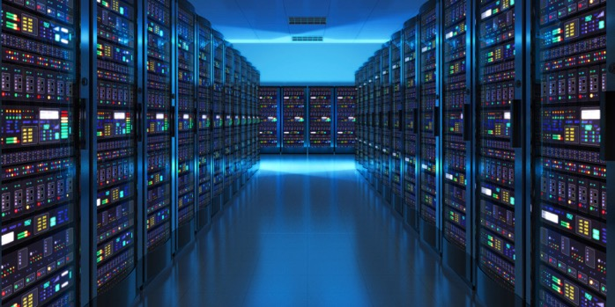
Datacenters that power the scalable website
Large-scale distributed systems: 10K – 100K servers
Each rack: 40 servers
Network: 10Gbps – 100Gbps in rack
10-100 MW of power
Source: “The Datacenter as a Computer --- An Introduction to the Design of Warehouse-Scale Machines”

Slide 33
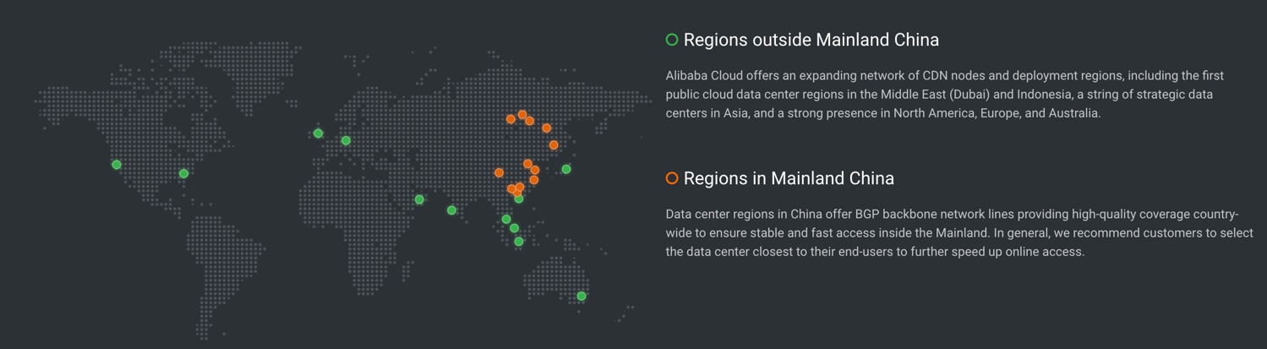
Geo-replicated datacenters
The locations of Alibaba datacenters
Source: https://www.alibabacloud.com/zh/global-locations

Slide 34
Design large-scale distributed system is challenging
Fault is common, how to handle it?

Slide 35
Fault is common: fault, error, failure
Fault can be latent or active
if active, get wrong data or control signals
Error is the results of active fault
e.g. violation of assertion or invariant of spec
discovery of errors is ad hoc (formal specification?)
Failure happens if an error is not detected and masked
not producing the intended result at an interface

Slide 36
Fault is common
, especially in large distributed systems
Why faults are common especially in distributed systems? Scale!
“Suppose a cluster has ultra-reliable server nodes with a stellar mean time between failures (MTBF) of 30 years (10,000 days)—a cluster of 10,000 servers will see an average of one server failure per day. ”
Source: The Datacenter as a Computer
-- An Introduction to the Design of Warehouse-Scale Machines

Slide 37


Fault is common
especially in large distributed systems
What are the causes?
Why faults are common especially in distributed systems? Scale!
“Suppose a cluster has ultra-reliable server nodes with a stellar mean time between failures (MTBF) of 30 years (10,000 days)—a cluster of 10,000 servers will see an average of one server failure per day. ”
Causes:
Operation error (human, configuration, etc.)
Software error (e.g., bug)
Hardware error
Power outage
Natural disaster
Source: The Datacenter as a Computer
-- An Introduction to the Design of Warehouse-Scale Machines

Slide 38
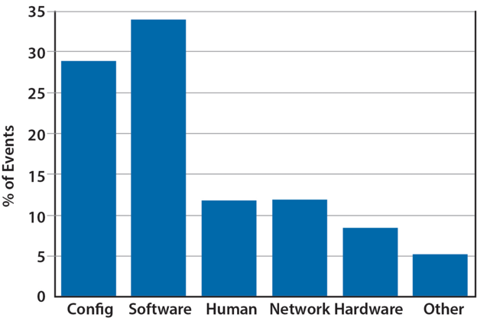
Fault is common
especially in large distributed systems
What are the causes?
Why faults are common especially in distributed systems? Scale!
“Suppose a cluster has ultra-reliable server nodes with a stellar mean time between failures (MTBF) of 30 years (10,000 days)—a cluster of 10,000 servers will see an average of one server failure per day. ”
Causes:
Operation error (human, configuration, etc.)
Software error (e.g., bug)
Hardware error
Power outage
Natural disaster
Source: The Datacenter as a Computer
-- An Introduction to the Design of Warehouse-Scale Machines

Slide 39
Faults and partial failures
On a single computer, it either works or it doesn’t
But in a distributed system, some parts of the system can be broken in some unpredictable way
Such failure is partial (aka., grey failure)
Since most other parts of the system are OK, we want the system still working!
Notes:
画一个big picture

Slide 40

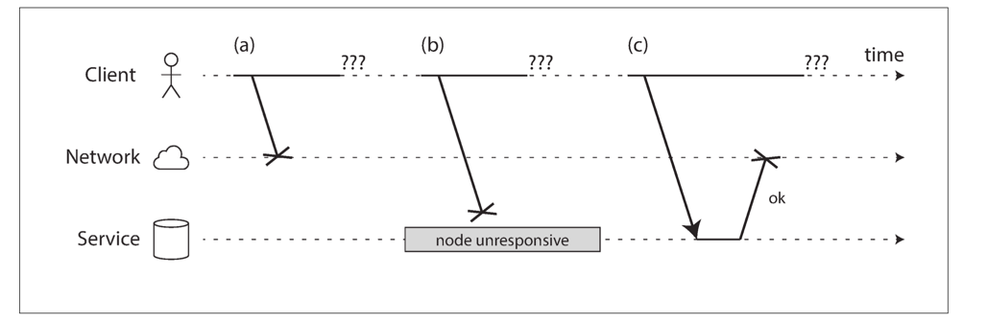
Faults and partial failures
Example: unreliable network
A client (e.g., Smartphone), sends requests to the service (e.g., Taobao), through network (5G, Wifi)
The client gets: “网络竟然奔溃了”, how can a network break?
Notes:
画一个big picture

Slide 41
Example: unreliable network
A user sends a request but the server does not reply, possible reasons:
1. The request may have been lost (e.g., someone unplugged a network cable).
2. The request may be waiting in a queue and will be delivered later (e.g., the network or the recipient is overloaded).
3. The remote node may have failed (e.g., it crashed or it was powered down).
Notes:
+ 淘宝的联系

Slide 42

Example: unreliable network
A user sends a request but the server does not reply, possible reasons:
4. The remote node may have temporarily stopped responding (e.g., it is experiencing a long garbage collection pause)
5. The remote node may have processed your request, but the response has been lost on the network (e.g., a network switch has been misconfigured).
6. The remote node may have processed your request, but the response has been delayed and will be delivered later (e.g., the network or your own machine is overloaded).

Slide 43
Another common fault: network partition
A network partition refers to network decomposition into relatively independent subnets
Can happen when a switch is being upgraded in a datacenter
Can even happen when being attacked by sharks
Network partition is usually a reality
You can never count on the network connectivity

Slide 44
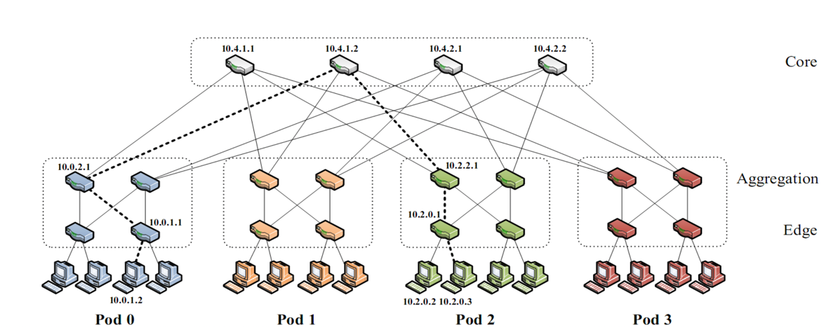
Another common fault: network partition
A network partition refers to network decomposition into relatively independent subnets
Can happen when a switch is being upgraded in a datacenter
For example, suppose the datacenter adopts a fat-tree topology
Source: https://www.cs.cornell.edu/courses/cs5413/2017sp/lectures/16-datacenter-topologies2.pdf

Slide 45
Another common fault: network partition
A network partition refers to network decomposition into relatively independent subnets
Can happen when a switch is being upgraded in a datacenter
For example, suppose the datacenter adopts a fat-tree topology
Source: https://www.cs.cornell.edu/courses/cs5413/2017sp/lectures/16-datacenter-topologies2.pdf

Slide 46
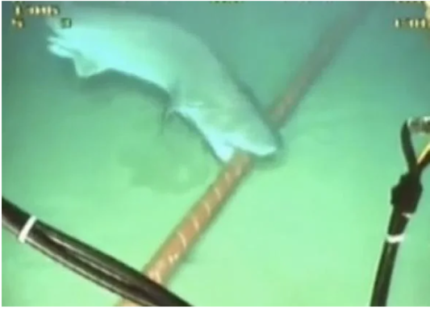
Another common fault: network partition
A network partition refers to network decomposition into relatively independent subnets
Can happen when a switch is being upgraded in a datacenter
Can even happen when being attacked by sharks
Source: https://slate.com/technology/2014/08/shark-attacks-threaten-google-s-undersea-internet-cables-video.html

Slide 47
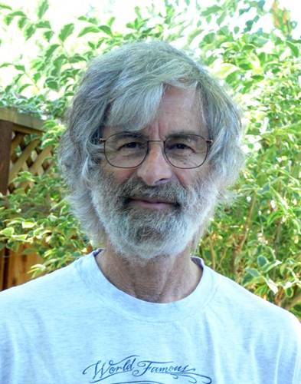
You know you have a distributed system when the crash of a computer you’ve never heard of stops you from getting any work done.
- Leslie Lamport
Lamport received the 2013 Turing Award for "fundamental contributions to the theory and practice of distributed and concurrent systems, notably the invention of concepts such as causality and logical clocks, safety and liveness, replicated state machines, and sequential consistency" in 2014.

Slide 48

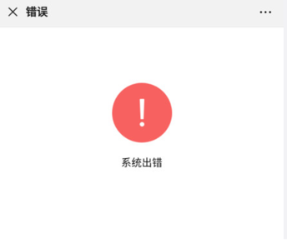
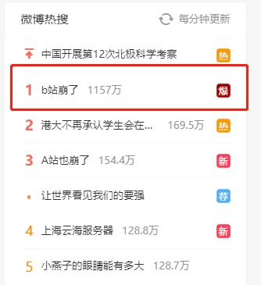


Notes:
More: GPU training

Slide 49
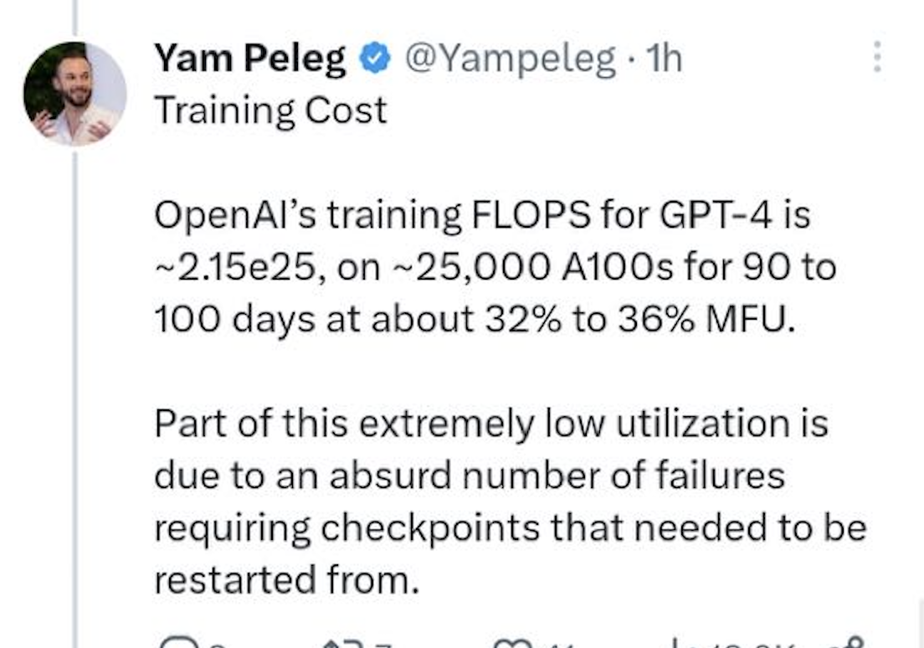
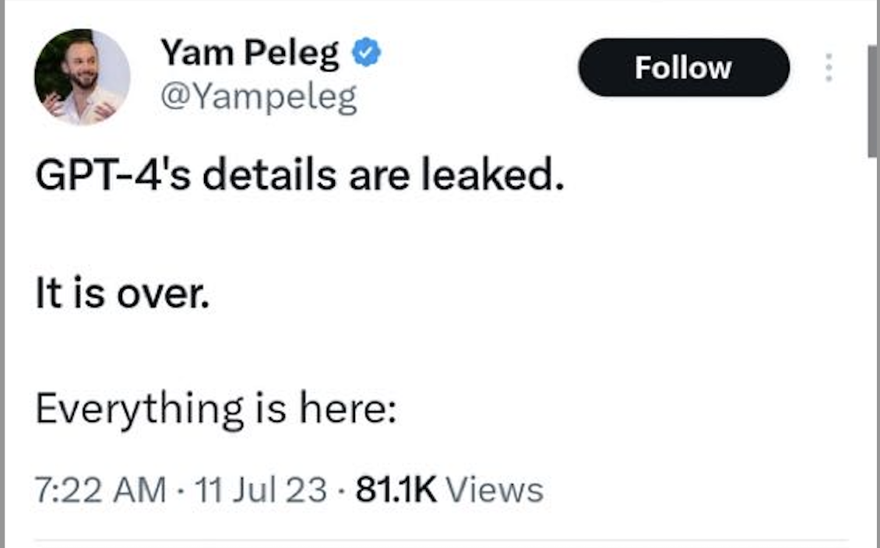

Slide 50
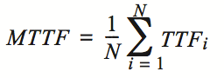
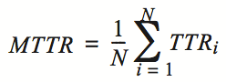
Availability and reliability
Availability: A measure of the time that a system was usable, as a fraction of the time that it was intended to be usable (x nines), corresponding downtime:
e.g. 3-nines -> 8 hour/year
e.g. 5-nines -> 5 min/year
e.g. 7-nines -> 3 sec/year
Metrics to measure reliability
MTTF: mean time to failure
MTTR: mean time to repair
MTBF: mean time between failure
MTBF = MTTF + MTTR

Slide 51





Large-scale systems can be highly available
Example#1: Internet, the BGP (Border Gateway Protocol) is highly available
Example#2: WeChat, Taobao & Baidu rarely (but not never) become outage
Example #3: OpenAI successfully trained GPT despite many failures ☺

Slide 52
Achieving high availability: handling failures w/ replications
Replication
replicas: identical multiple copies
Example: replicated file servers
If one copy survives, the application is available
Application
generate the web page
Application server
Local area network
File server
File server
File server
File:
image
File:
image
File:
image
Identical copies

Slide 53
Challenge: consistency
Replication
replicas: identical multiple copies
Example: replicated file servers
If one copy survives, the application is available
Challenge: consistency
Application
generate the web page
Application server
Local area network
File server
File server
File server
File:
image
File:
image
File:
image

Slide 54
Challenge: consistency
Replication
replicas: identical multiple copies
Example: replicated file servers
If one copy survives, the application is available
Challenge: consistency
Application put file A to one server
Application
generate the web page
Application server
1
Local area network
File server
File server
File server
File:
image
File:
image
File:
image

Slide 55
Challenge: consistency
Replication
replicas: identical multiple copies
Example: replicated file servers
If one copy survives, the application is available
Challenge: consistency
Application put file A to one server
The server crashed
Application
generate the web page
Application server
Local area network
2
File server
File server
File server
File:
image
File:
image
File:
image

Slide 56
Challenge: consistency
Replication
replicas: identical multiple copies
Example: replicated file servers
If one copy survives, the application is available
Application put file A to one server
The server crashed
What happens when read A again?
Application
generate the web page
Application server
Local area network
3
File server
File server
File server
File:
image
File:
image
File:
image

Slide 57

Achieving high availability: handling failures
Replication
replicas: identical multiple copies
Techniques to cope with consistency:
Primary-backup replication
Replicated state machine
…

Slide 58
Achieving high availability: handling failures via retry
Restart or reconstruct
Monitoring and catching errors
Restart or reconstruct the system (sub-system)
E.g., restart the stateless application server is ok
What about consistency? Must made trade-off
Stateless applications does not have consistency issue
Some applications, like Google search, can even tolerate occasional inconsistency
Can you notice the inconsistency of search results?

Slide 59
The CAP theorem
Consistency, Availability & Partition tolerance

Slide 60
CAP: an example
Amazon has two zones: US and Euro
All US users connect to the US zone
All Euro users connect to the Euro zone
Define Availability and Consistency
C: all users see the actual number of items
Not-C: users see 1 item left, but actually is 0
A: all users can buy items at any time (if there are some)
Not-A: users might get "cannot buy now, please wait and retry"

Slide 61
The CAP theorem: 2 out of 3
It is impossible for a distributed computer system to simultaneously provide all three of the following guarantees
Consistency (all nodes see the same data at the same time)
Availability (a guarantee that every request receives a response about whether it succeeded or failed)
Partition tolerance (the system continues to operate despite arbitrary message loss or failure of part of the system)
v₀
v₀
v₀
v₀
v₁
v₀
v₁
v₀
v₁
v₀
S₁
S₂
S₁
S₂
S₁
S₂
S₁
S₂
S₁
S₂
S₁
S₂
A=v₁
done
A=?
1. A=v₀
C
C
C
C
C
C
2. Not available

Slide 62


Partition Tolerance
"P" is usually a reality
You can never count on the network connectivity
AP: sacrifice C
If you have one book but sell it to two customers
Maybe just an apology and a small gift coupon
CP: sacrifice A
If you are selling train ticket but cannot deliver
Customer may sue you
But the user can fail to buy the ticket, e.g., 12306 during spring festival in the last few years

Slide 63
CAP: not a Binary Decision
Example: a CP system does not mean no "A" at all during network partition
If the Euro zone and US zone are disconnected, the US zone can still keep available
Only the Euro zone is not available
When the network connects again, apply US zone data to Euro zone for consistency

Slide 64
Summary of the (ideal) properties of distributed systems
Can our system handle a larger workload?
Scalability
How easy the developer
can use our system?
How fast is our system?
Ease of programming
Performance
Consistency
Fault tolerance
Is our data/computation
correct?
What if some component crash?

Slide 65
Summary of the (ideal) properties of distributed systems
Sharding
Replication
Load balancing
New hardware
Scalability
Ease of programming
Performance
DSM, RPC, MapReduce, …
Caching
Consistency
Fault tolerance
Sequential, eventual,
consensus, isolation, etc.
High availability: replication & checkpointing
Durability: atomicity, logging, etc.

Slide 66
Summary of the (ideal) properties of distributed systems
These properties typically cannot achieve at the same time
The adults want them all, but the reality forces them to make trade-offs
Remote Procedure Call (RPC)
Distributed Shared Memory (DSM)
Scalability
Scalability
Ease of
programming
Performance
Ease of
programming
Performance
Consistency
Fault tolerance
Consistency
Fault tolerance
NoSQL databases
NewSQL databases (e.g., Spanner)
Scalability
Scalability
Ease of
programming
Performance
Ease of
programming
Performance
Consistency
Fault tolerance
Consistency
Fault tolerance

